Slide 1
Return Policy – Jewelry Retail
Mia Bajic, McCall James, Timothy Nguyen,
Jared Sinsheimer, Hale Tussing

Slide 2
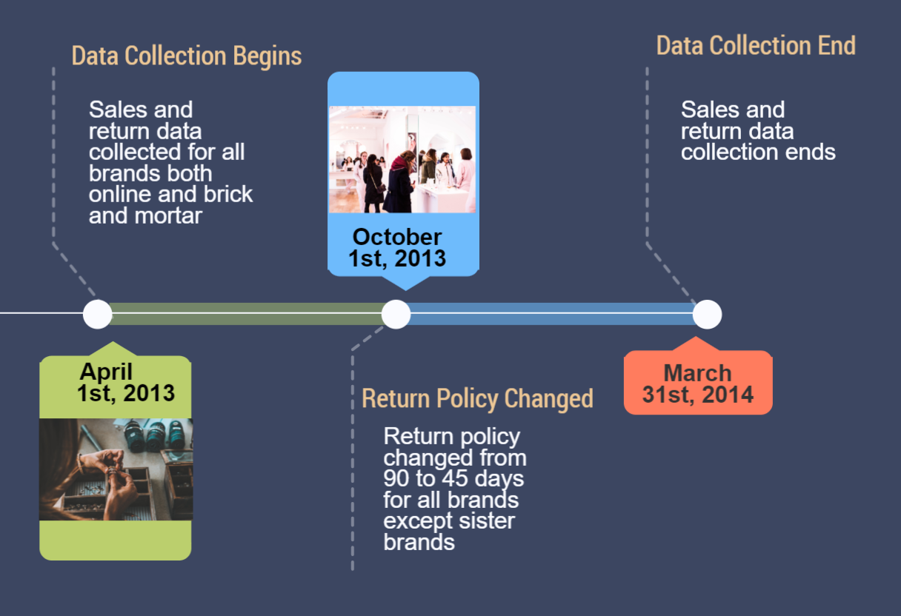
Notes:
Transaction data between April 1st, 2013 and March 31st, 2014
Return policy was shortened from 90 days to 45 days on October 1st, 2013
Return policy remains unchanged for online store 10 (sister brand) and brick and mortar store 8 (sister brand
How does implementing a 45 day return policy impact sales and returns for brick and mortar stores and online channel both at the store level and product level?

Slide 3
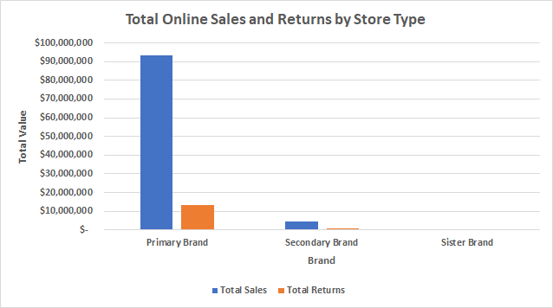
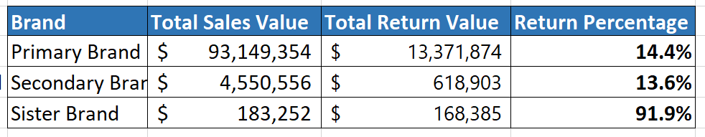
Business Snapshot - Online
.

Slide 4
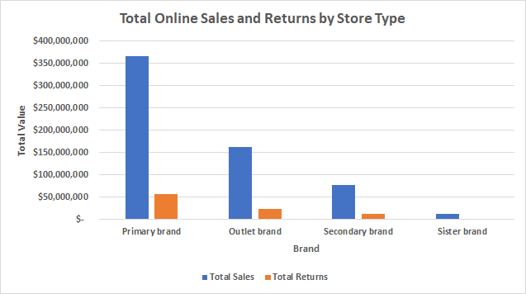
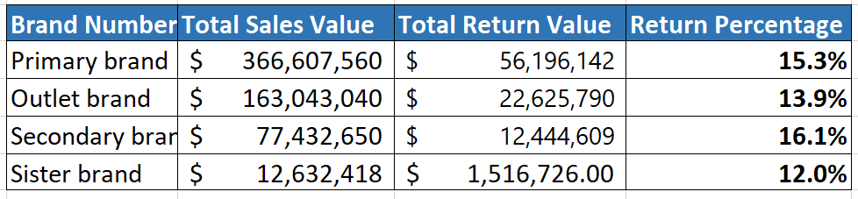
Business Snapshot - Brick and Mortar

Slide 5
Store Level
ONLINE | Dollars | Quantity
Sales | No proven impact | No proven impact
Returns | No proven impact | No proven impact
BRICK AND MORTAR | Dollars | Quantity
Sales | No proven impact | 17.86%
Returns | 47.25% | 18.01%
Notes:
Online: The policy change had no significant impact on sales or returns for the online channel.
Physical: The policy change increased purchase quantity, but not sales dollars.
More purchases, no proven impact on sales in dollars. Items purchased could be cheaper. Fewer returns, especially of expensive items.

Slide 6
Product Level
ONLINE | Dollars | Quantity
Sales | No proven impact | No proven impact
Returns | 39.72% | No proven impact
BRICK AND MORTAR | Dollars | Quantity
Sales | 8.04% | 17.4%
Returns | 49% | 11.37%
Notes:
Online: No proven impact except decreased returns in dollars. Could be returning same quantity but returning expensive items less often.
Physical: More purchases, but of cheaper items. Fewer returns, especially of expensive items.

Slide 7
How does the impact of the policy change vary across product categories?

Slide 8
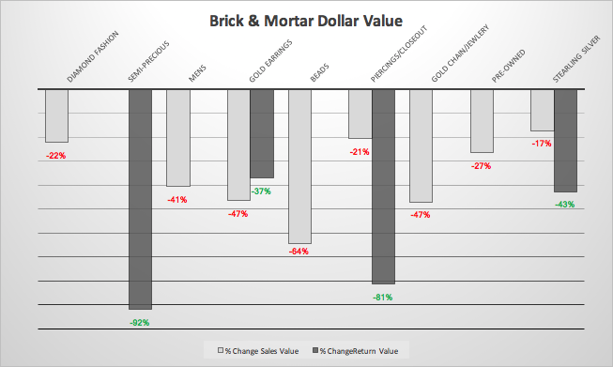
Notes:
Dollar Value: Many product categories showed large declines in returns and sales, while diamond fashion, gold chain/jewelry, and mens had a decrease in only sales.

Slide 9
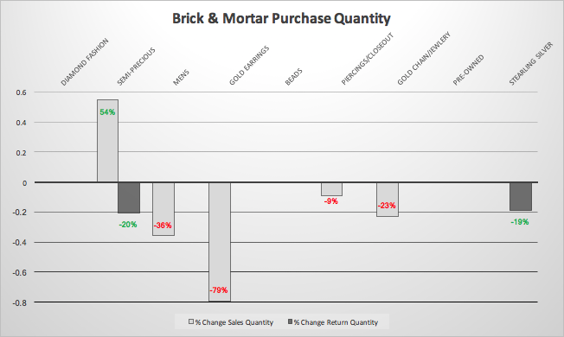
Notes:
Purchase Quantity: Semi-Precious sales increased and returns decreased. Mens, Gold Earrings, Piercings/Closeout and Gold Chain/Jewelry sales decreased. Sterling Silver returns decreased.

Slide 10
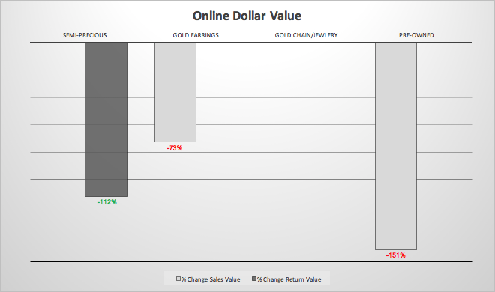
Notes:
Dollar Value: Semi-Precious returns decreased, Gold Earrings sales decreased, and Pre-Owned sales decreased.

Slide 11
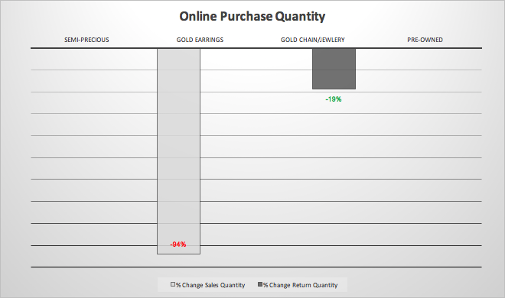
Notes:
Purchase Quantity: Gold Earrings sales decreased and Gold Chain/Jewelry returns decreased.

Slide 12
Policy Recommendation #1: Two Policies
Online Policy: Keep current policy for all brands because 45 day return policy has no proven impact on store-level sales or returns, and implementing it would create extra cost with no benefit.
Brick and Mortar Policy: Implement 45 day policy for all brands because it increases store-level purchases and decreases store-level returns.

Slide 13
Policy Recommendation #2: Product Category Policies
Semi-Precious: Implement 45 day policy for semi-precious product category both for online margin to increase by 3.7% and brick and mortar margin to increase by 4.5%.
All other product categories: Keep current policy as 45 day policy would decrease margins.
Notes:
This is a margin analysis assuming margin = 50% of sales in dollars and return cost = 4% of returns in dollars.

Slide 14
Appendix
Margin Analysis
Endogeneity
Summary Statistics
Poisson vs. NB Tests
Model Fit
Heteroskedasticity

Slide 15
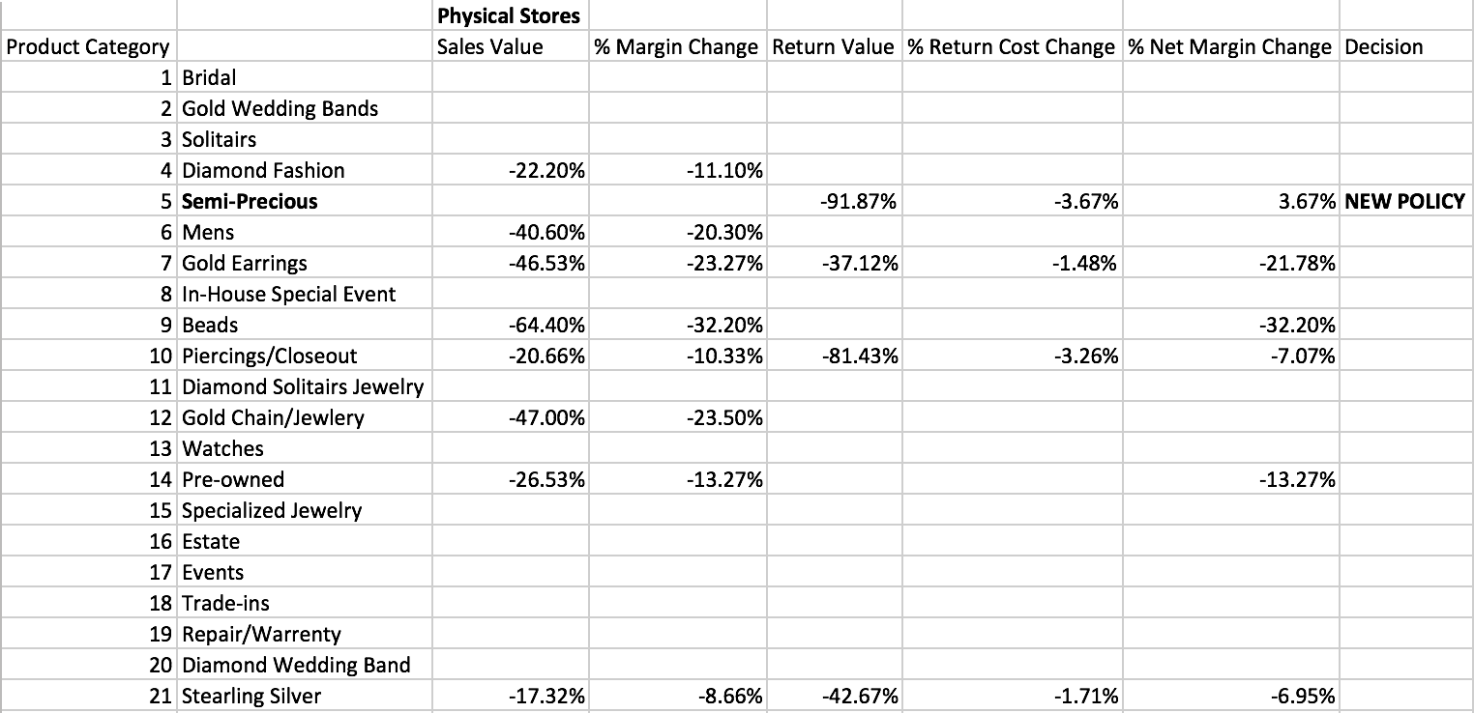
Margin Analysis

Slide 16
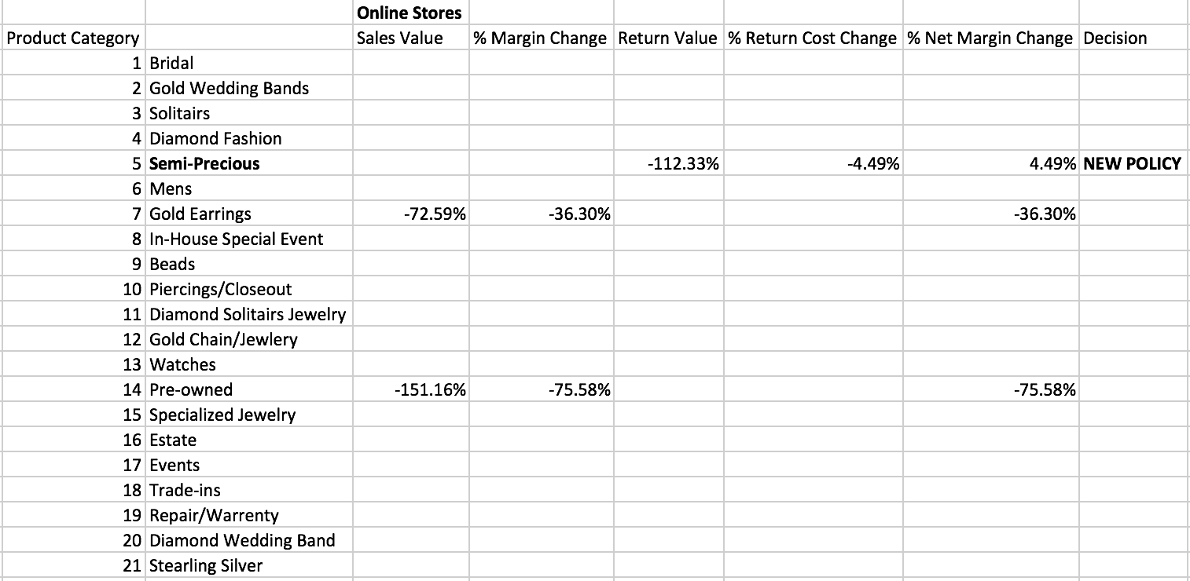
Margin Analysis Cont.

Slide 17
Endogeneity
The numbers shown above are taking a comparison of a control group and treatment group over the same time period which removes endogeneity caused by:
Seasonality
Including wedding/anniversary season, holidays and any event days
Major economic events
Omitted variable bias

Slide 18
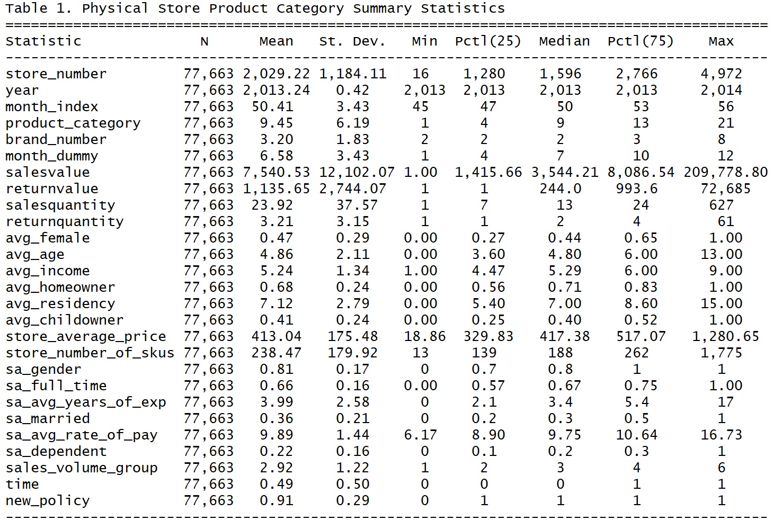

Slide 19
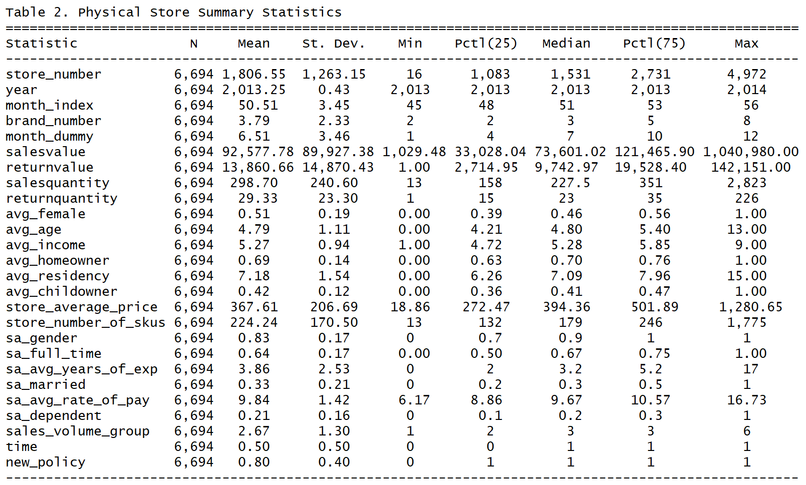

Slide 20
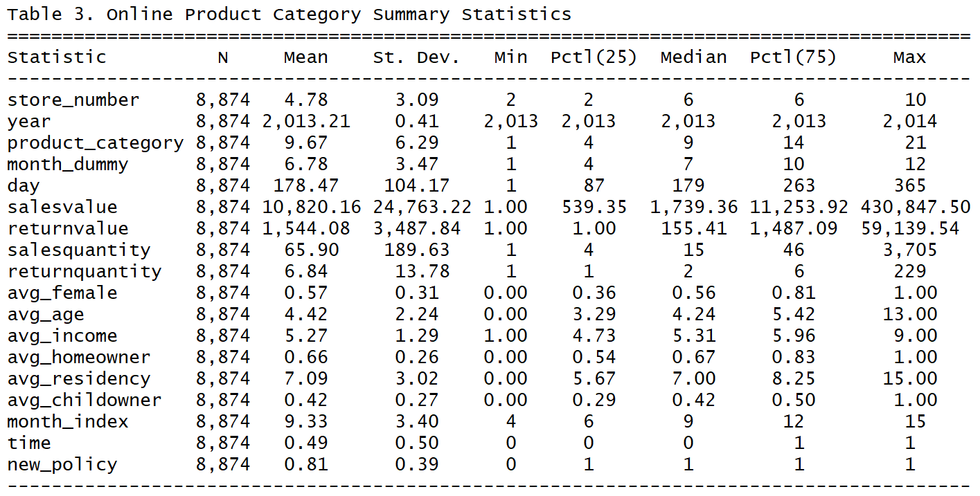

Slide 21
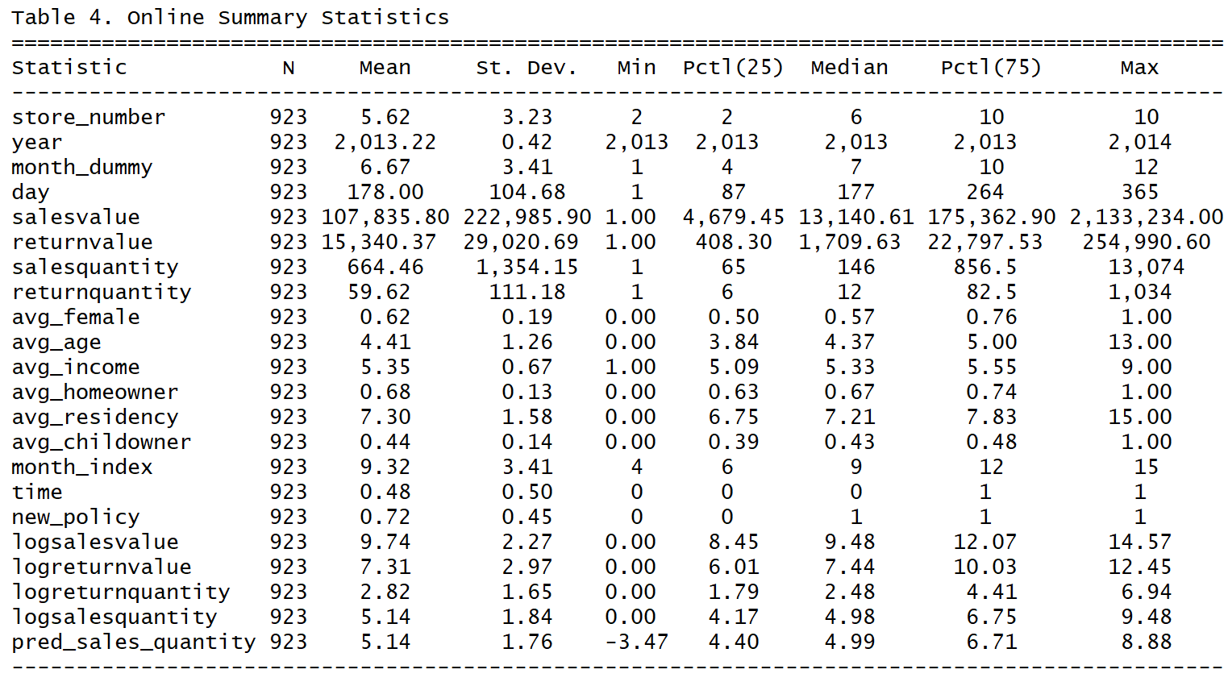

Slide 22
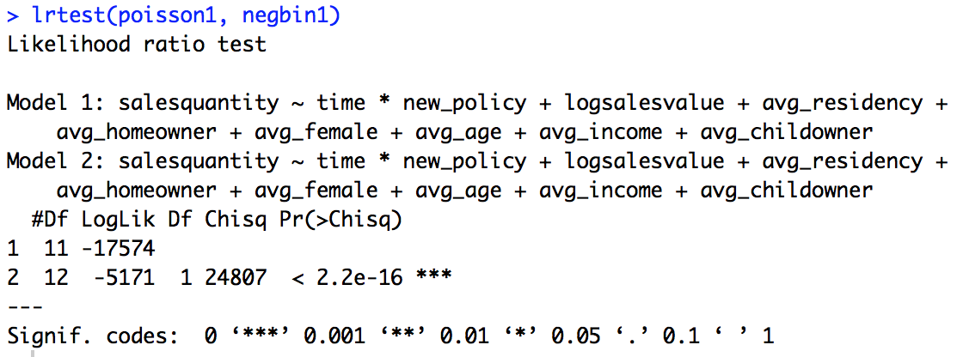
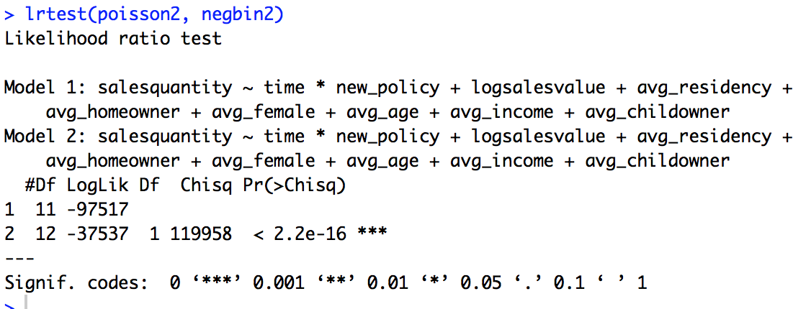
Poisson vs NB
(Negative binomial because E[X]<V[X])
LR Tests for Poisson Models vs. Negative Binomial Models
Question #1:
Question #2:

Slide 23
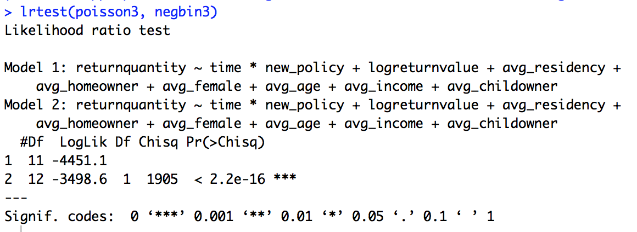
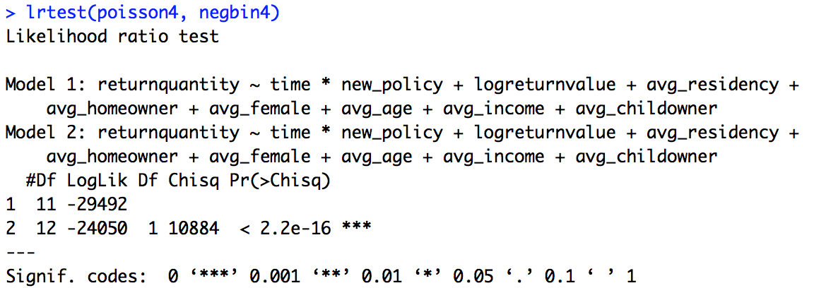
Poisson vs. NB
Question #3:
Question #4:

Slide 24
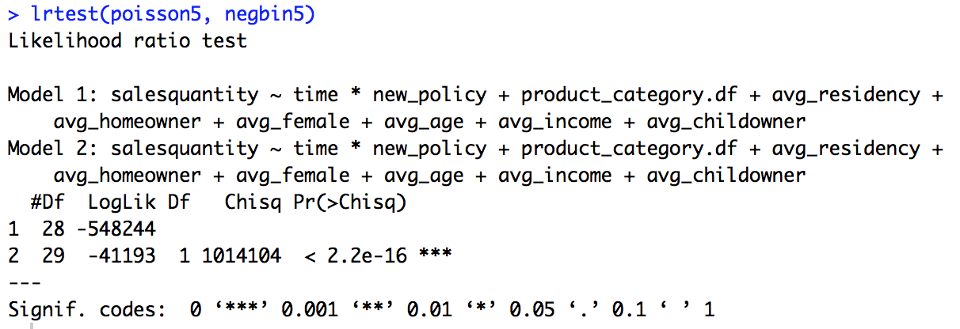
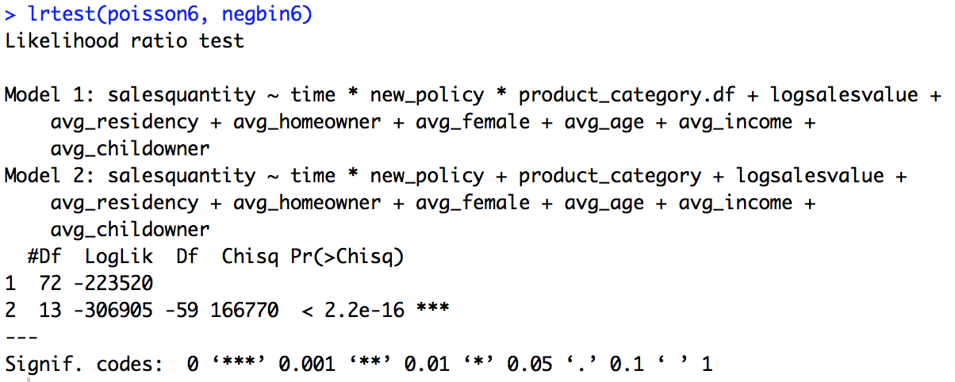
Poisson vs. NB
Question #5:
Question #6:

Slide 25
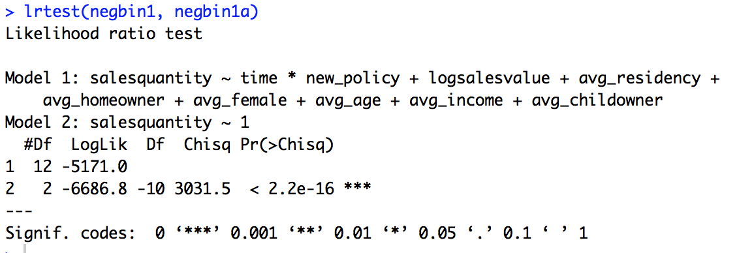
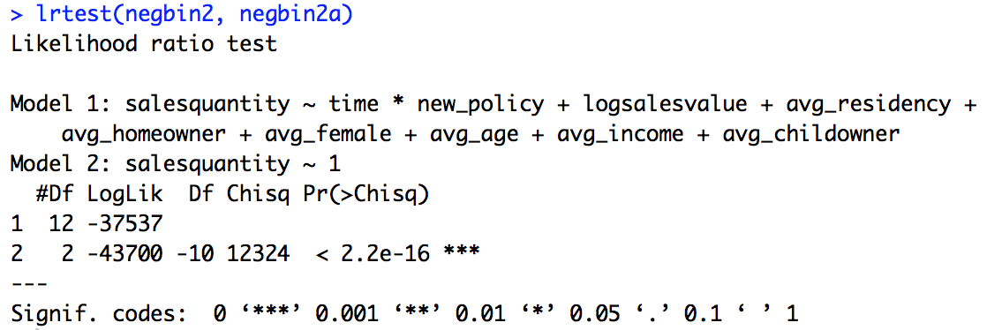
Model Fit
Question #1:
Question #2:

Slide 26
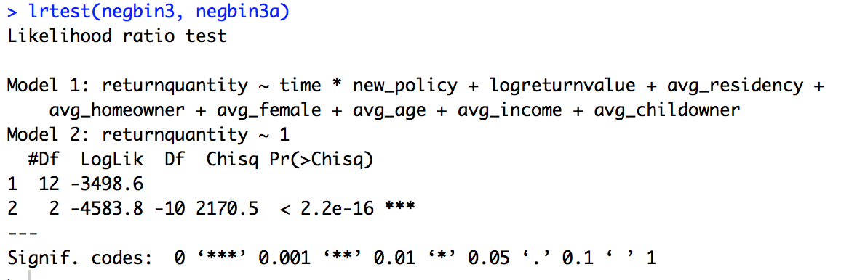
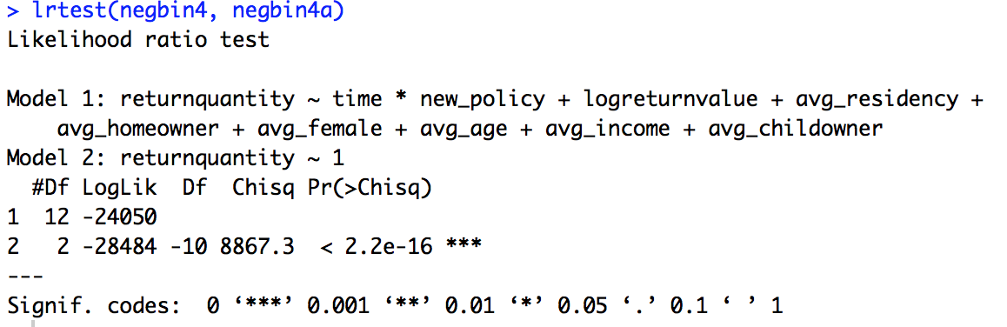
Model Fit
Question #3
Question #4

Slide 27
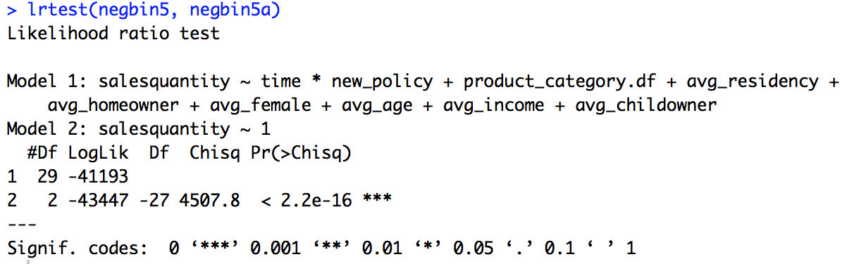
Model Fit
Question #5
Question #6 uses same models

Slide 28
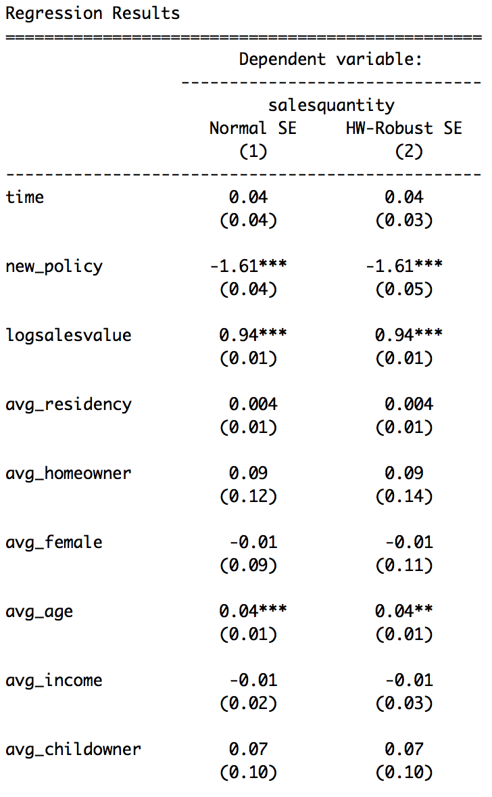
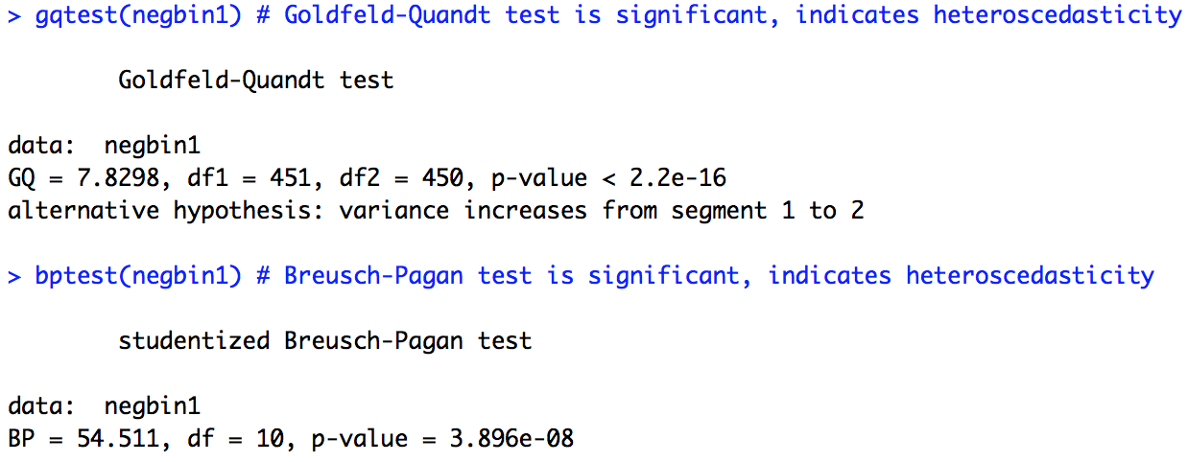
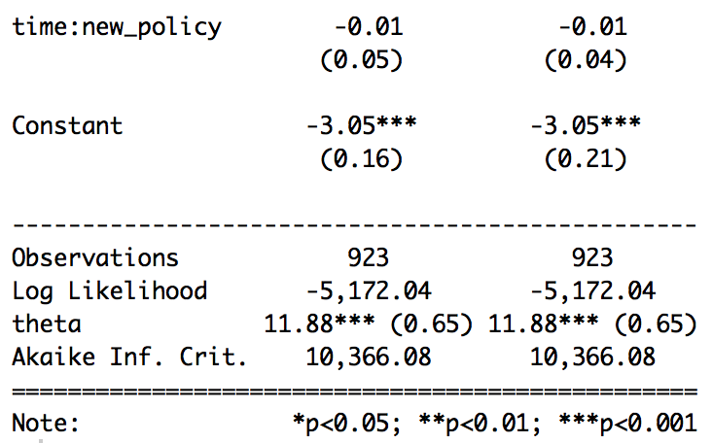
Heteroscedasticity
Question #1

Slide 29
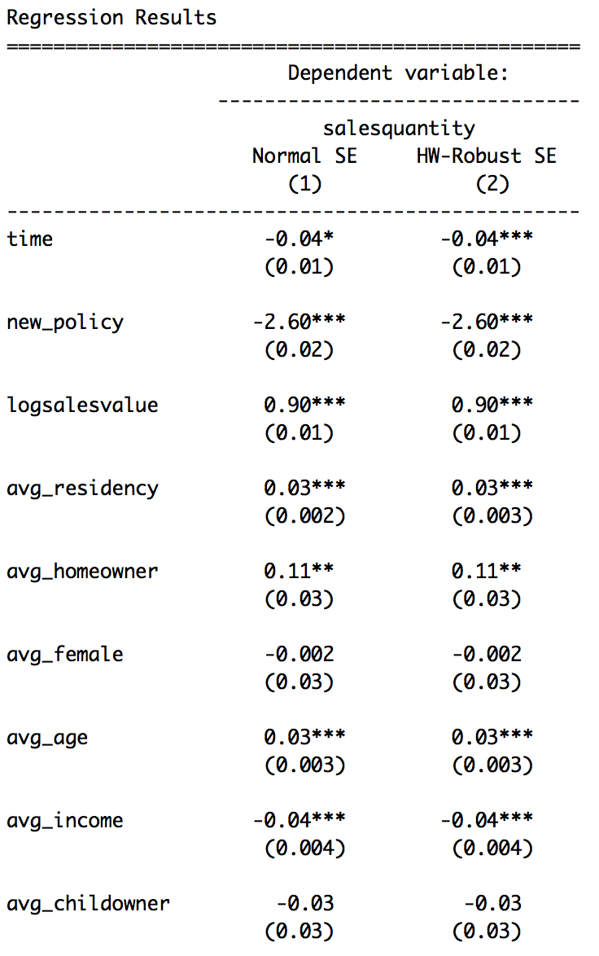
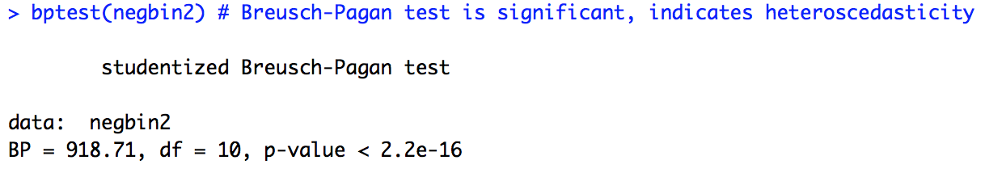
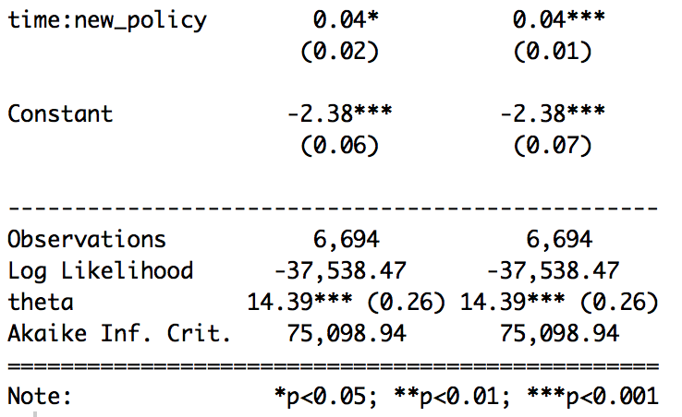
Heteroscedasticity
Question #2

Slide 30
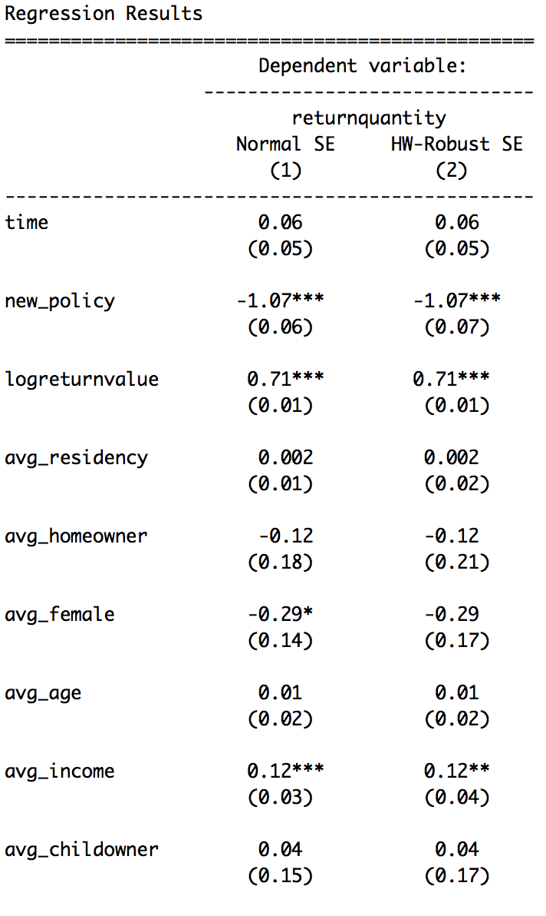
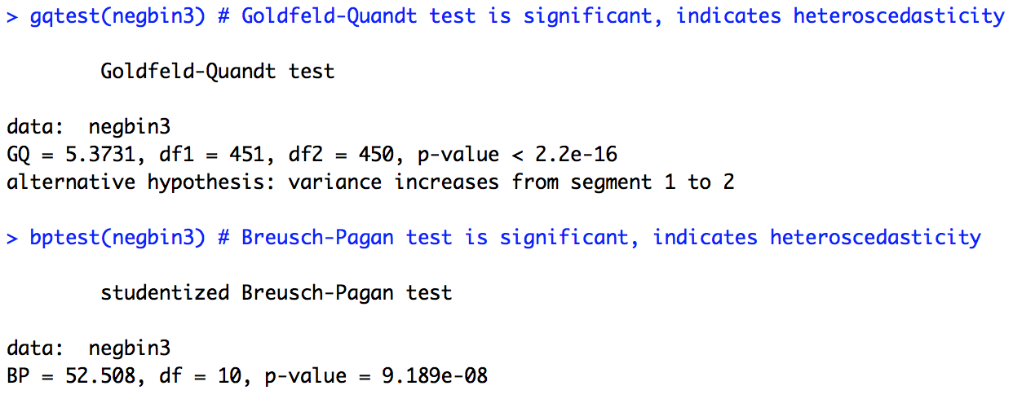
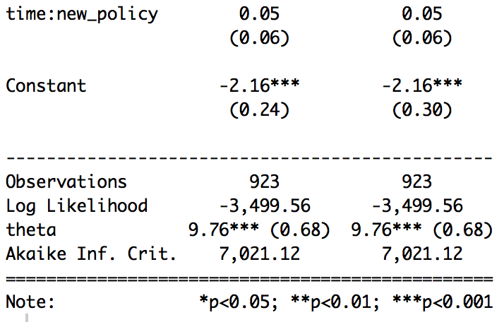
Heteroscedasticity
Question #3

Slide 31
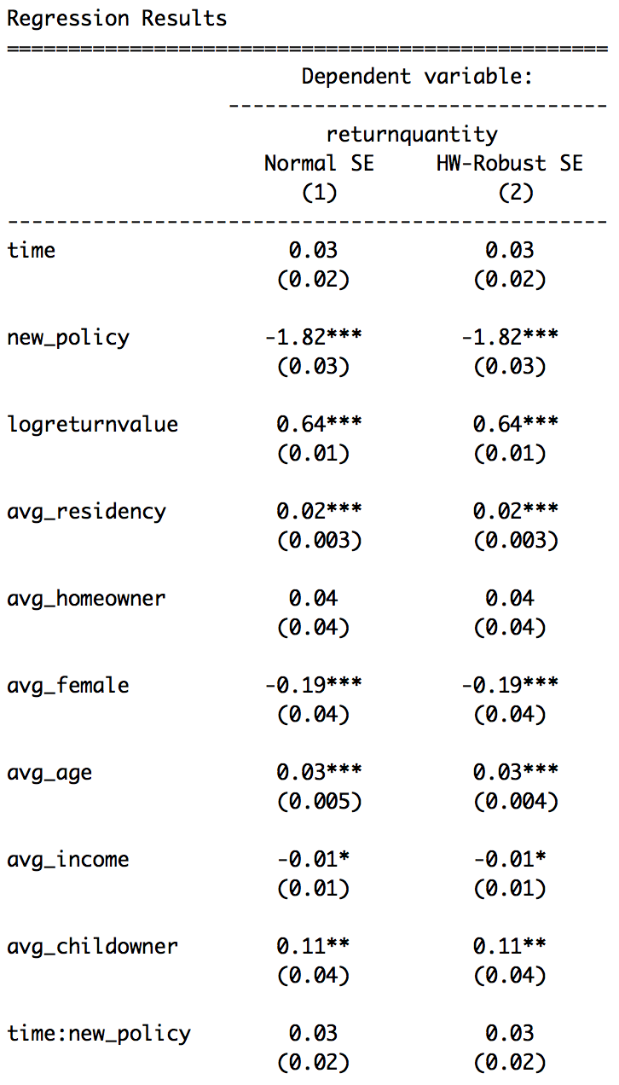
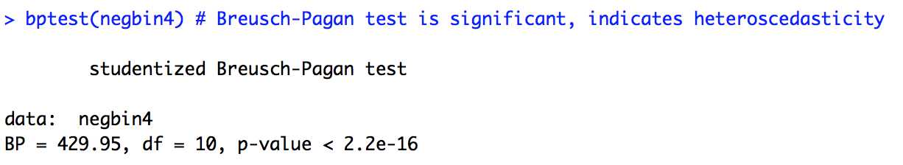
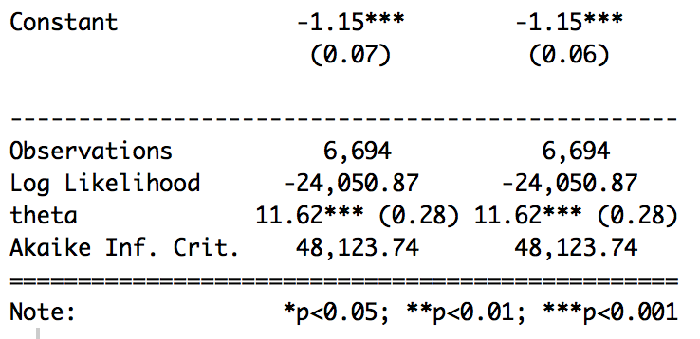
Heteroscedasticity
Question #4

Slide 32
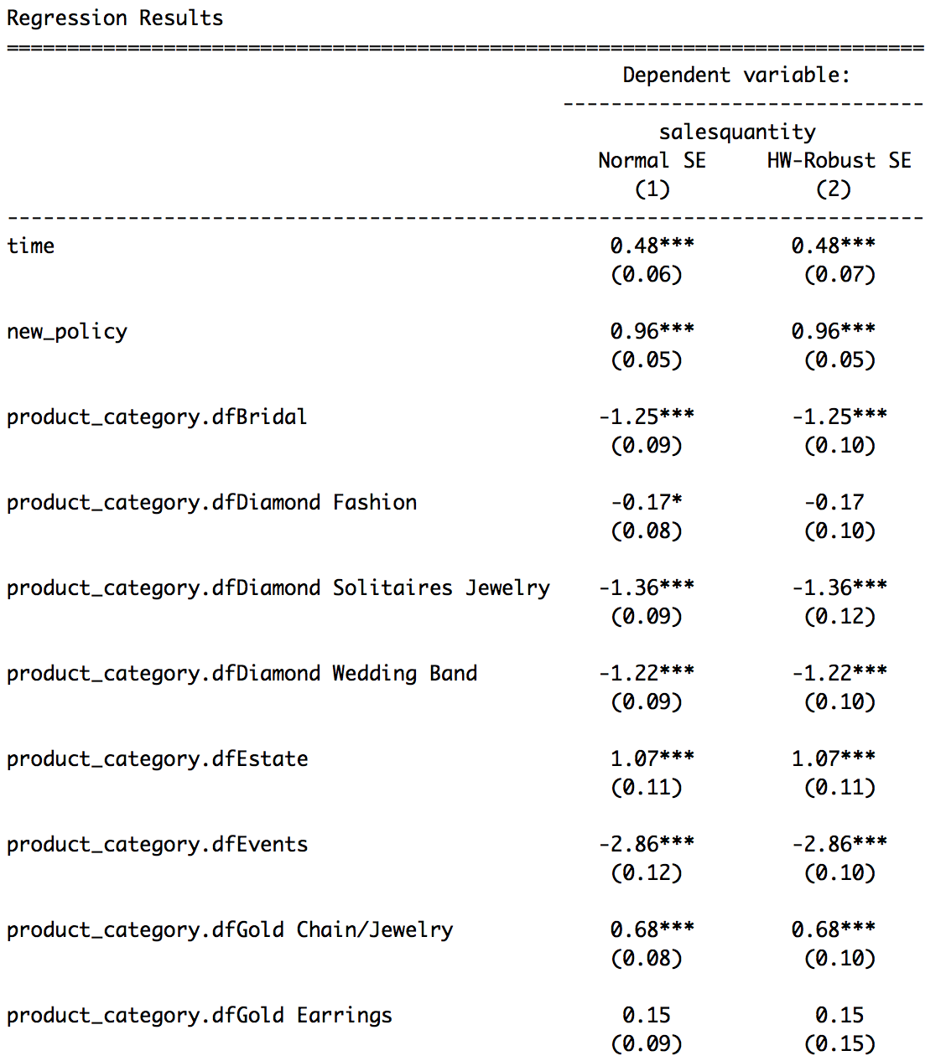
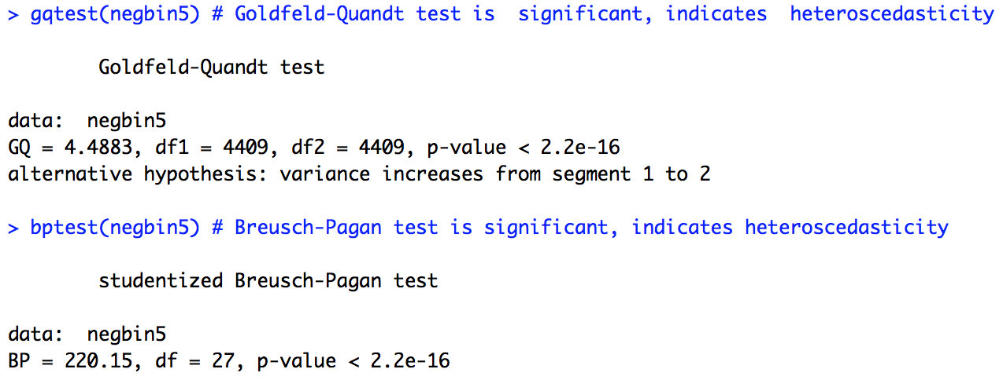
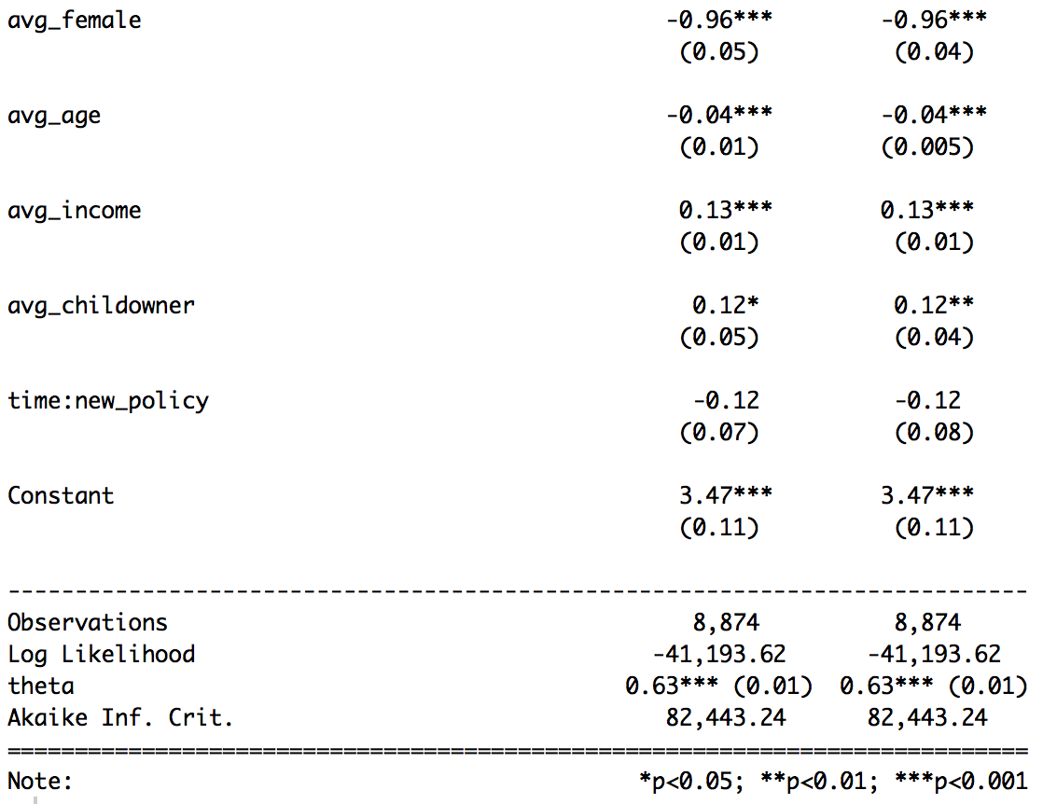
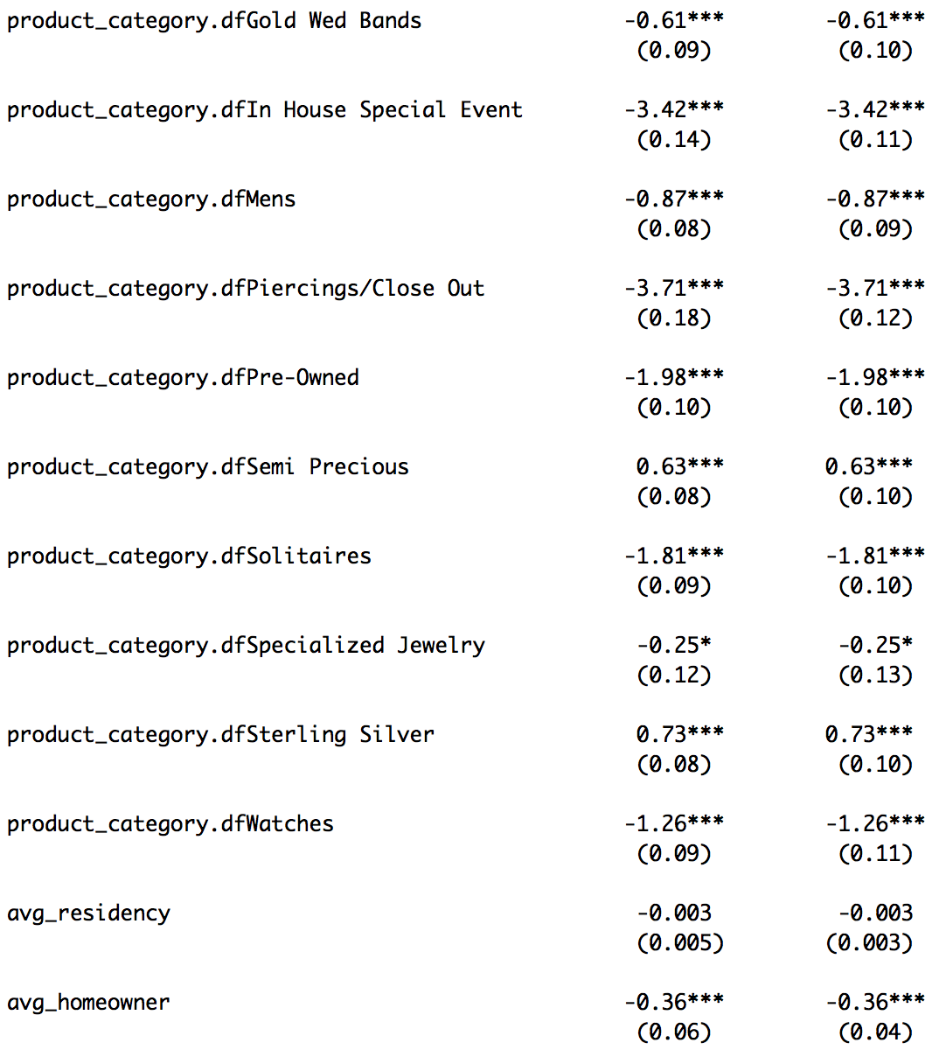
Heteroscedasticity
Question #5

Slide 33
Heteroscedasticity
Question #6 uses same models

